Slide 1

Floyd's Tortoise and Hare Algorithm
By Sandhya Kiran Donthireddy

Slide 2
Why?
Finding a cycle in a sequence of iterated function values
2, 0, 6, 3, 1, 6, 3, 1, 6, 3, 1, ....
The cycle in this value sequence is 6, 3, 1

Slide 3
Algorithm
Pointer algorithm that uses only two pointers, which move through the sequence at different speeds

Slide 4
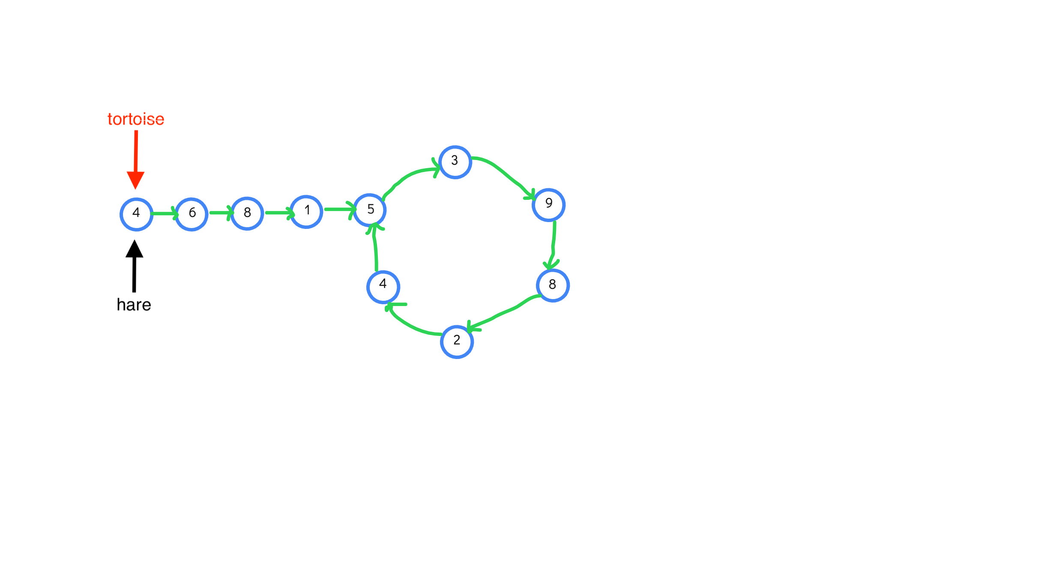

Slide 5
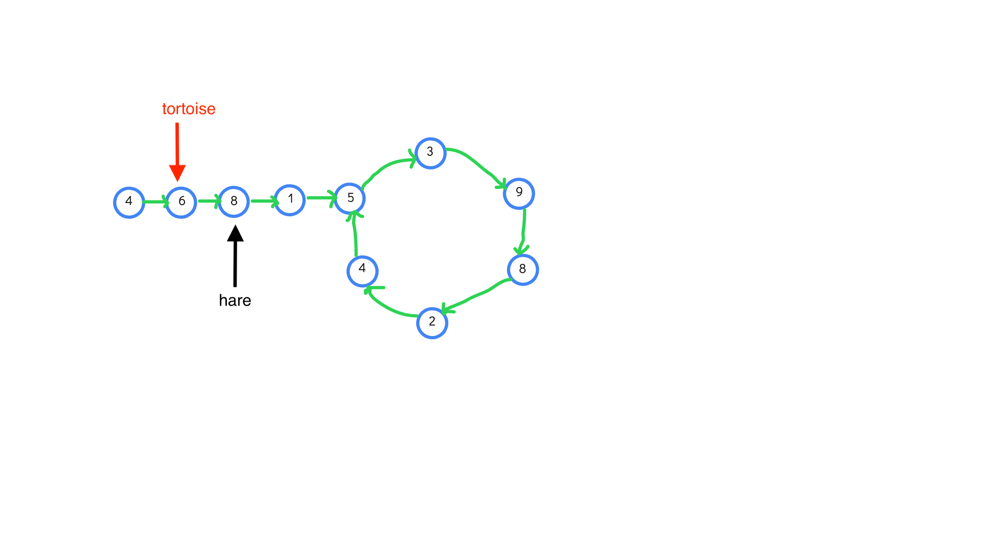

Slide 6
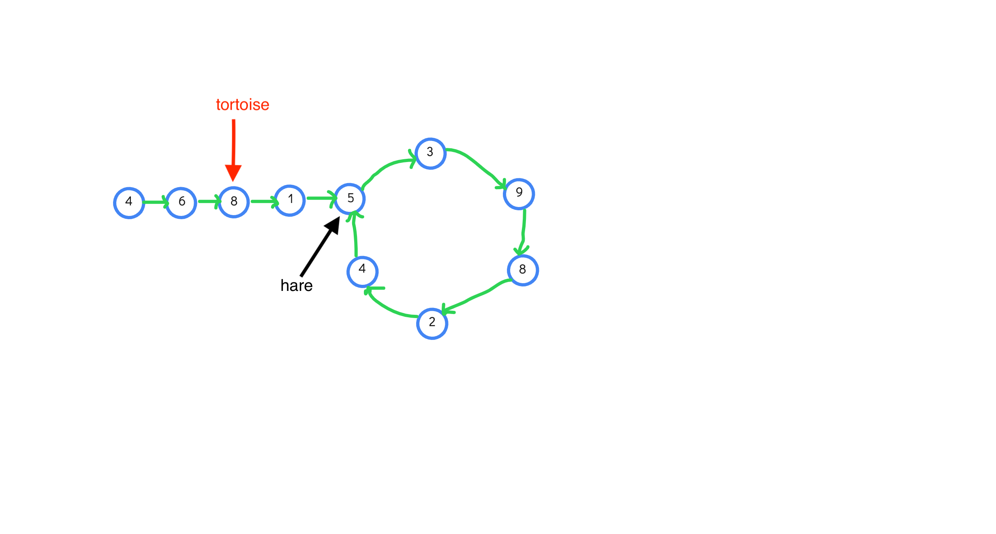

Slide 7
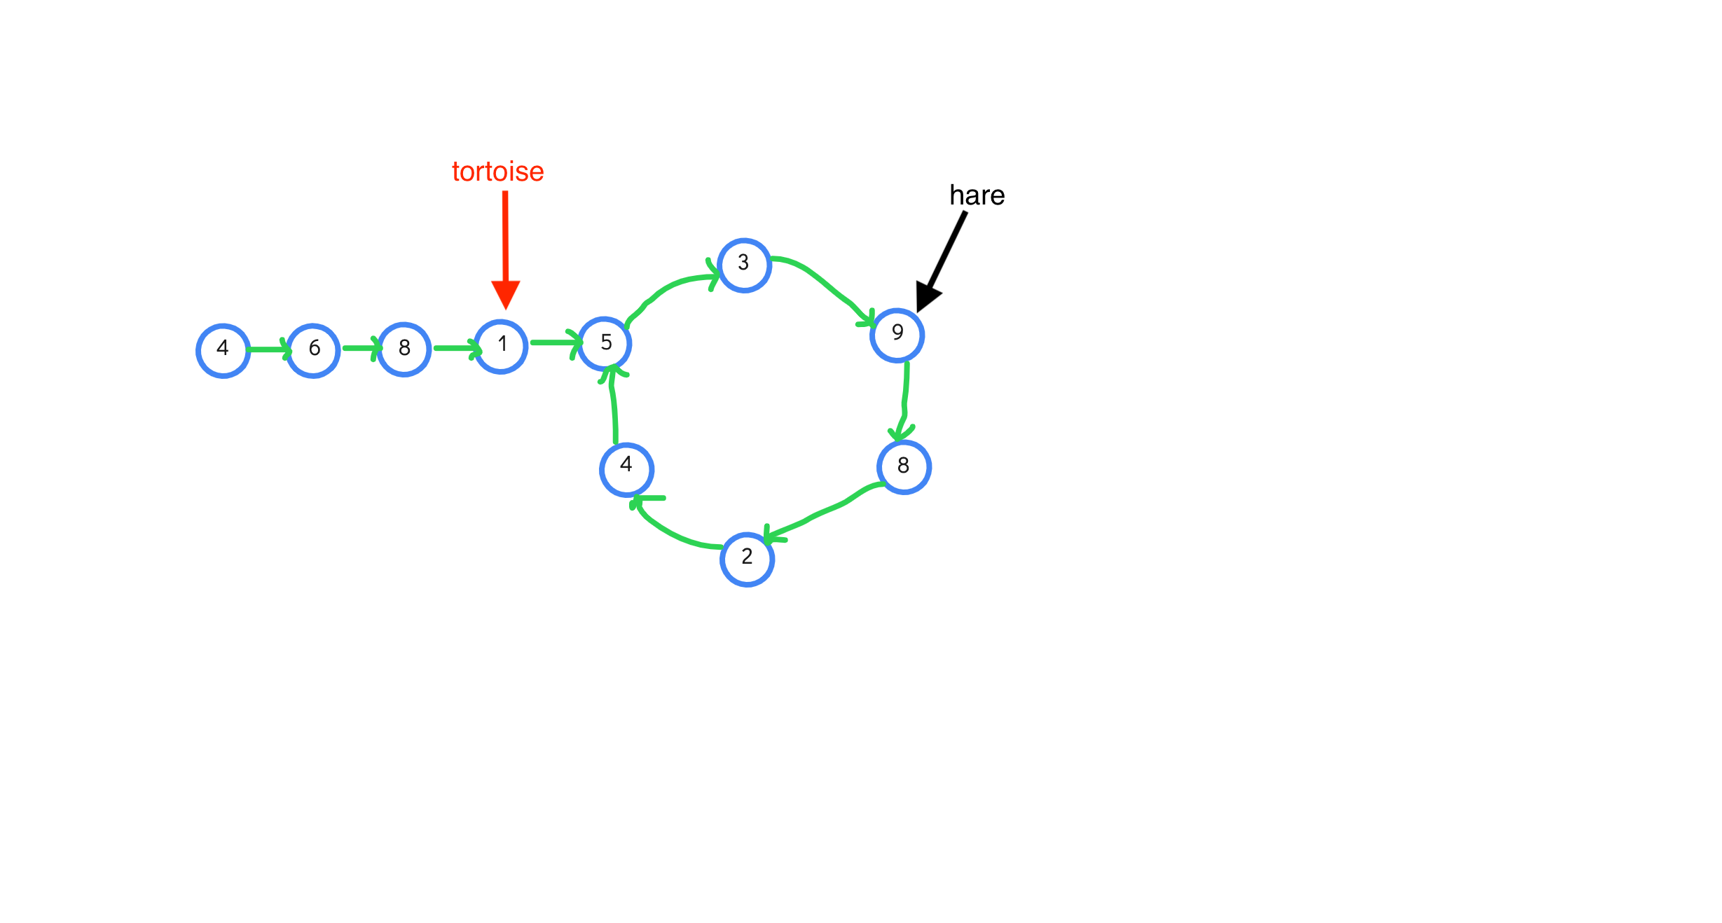

Slide 8
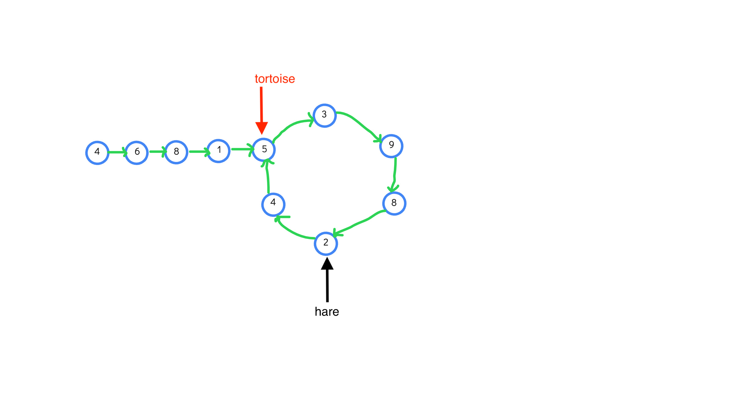

Slide 9
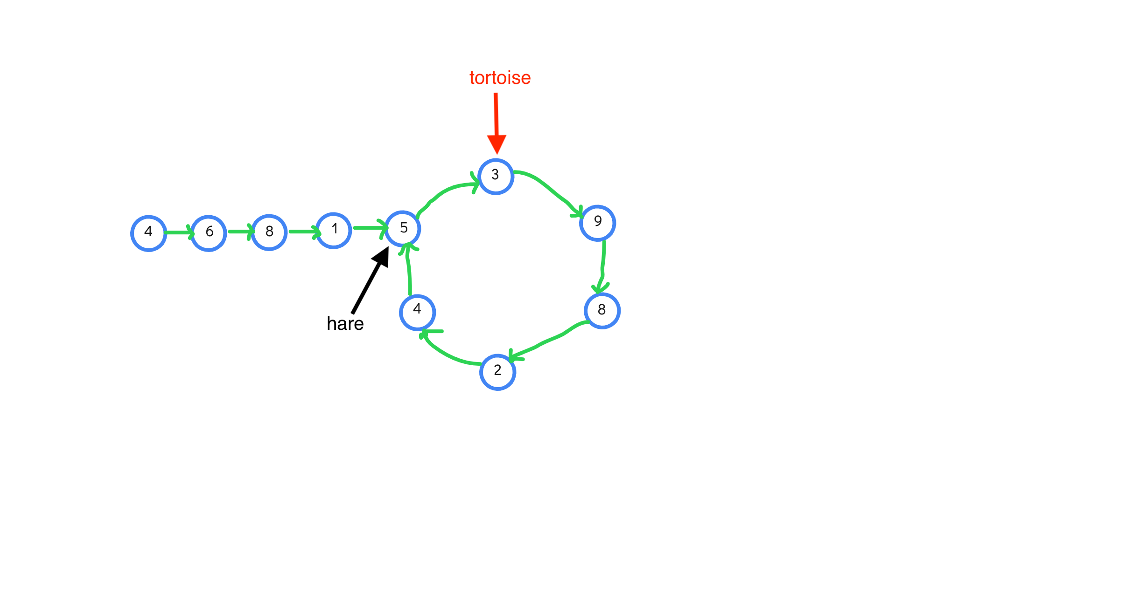

Slide 10
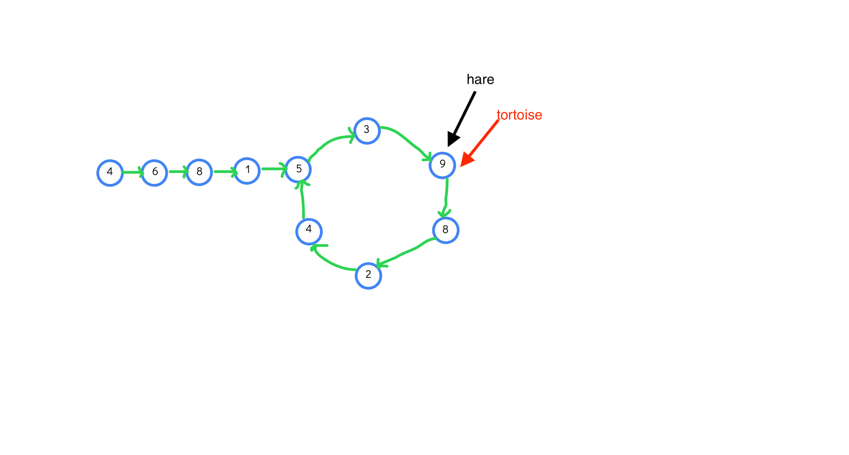

Slide 11
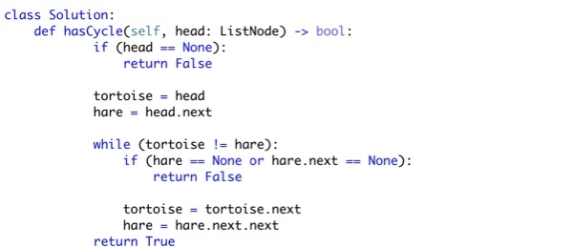
Python Code

Slide 12
THANK YOU

